Slide 1

COURSE TITLE: ENTREPRENEURSHIP AND Technology Commercialization
Course Code: ES391
Course Instructor: Dr. Fahd S. Khan
Ghulam Ishaq Khan Institute Of Engineering Sciences and Technology

Slide 2
INTRODUCTION TO ENTREPRENEURSHIP
The word entrepreneur derives from the French words entre, meaning “between,” and prendre, meaning “to take.”
The word was originally used to describe people who “take on the risk” between buyers and sellers or who “undertake” a task such as starting a new venture.
Entrepreneurship
Defined as the process by which individuals pursue opportunities without regard to resources they currently control for the purpose of exploiting future goods and services.

Slide 3
Typically, established firms with an entrepreneurial emphasis are proactive, innovative, and risk-taking. For example, Google is widely recognized as a firm in which entrepreneurial behaviors are clearly evident.
Google search engine, Gmail, Google Maps, Google Earth, or Google Home. Google is currently working on a bevy of far-reaching innovations, such as a virtual reality platform for Android and self-driving cars.
Established firms with an orientation toward acting entrepreneurially practice corporate entrepreneurship. All firms fall along a conceptual continuum that ranges from highly conservative to highly entrepreneurial. The position of a firm on this continuum is referred to as its entrepreneurial intensity.

Slide 4
Why become an Entrepreneur ?
Be Your Own Boss
The first of these reasons—being one’s own boss—is given most commonly. This doesn’t mean, however, that entrepreneurs are difficult to work with or that they have trouble accepting authority.
Pursue Own Ideas
The second reason people start their own firms is to pursue their own ideas. Some people are naturally alert, and when they recognize ideas for new products or services, they have a desire to see those ideas realized.
Pursue Financial Rewards
People start their own firms to pursue financial rewards. This motivation, however, is typically secondary to the first two and often fails to live up to its hype. The average entrepreneur does not make more money than someone with a similar amount of responsibility in a traditional job.

Slide 5
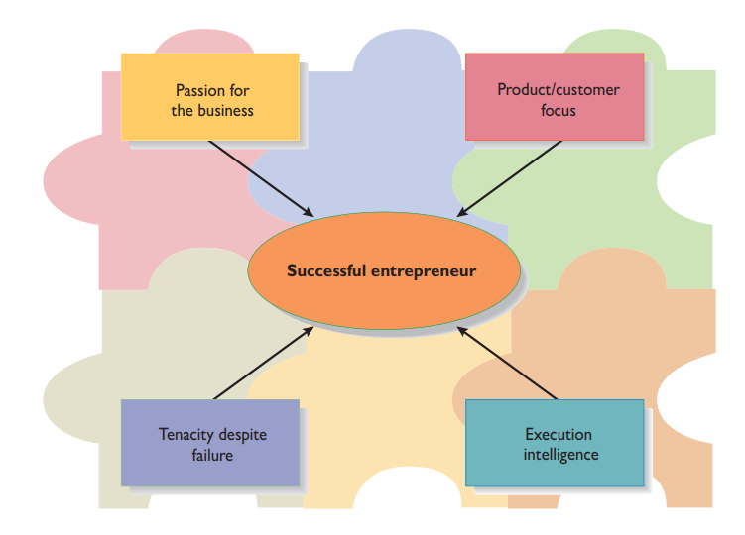
Characteristics of an Entrepreneur

Slide 6
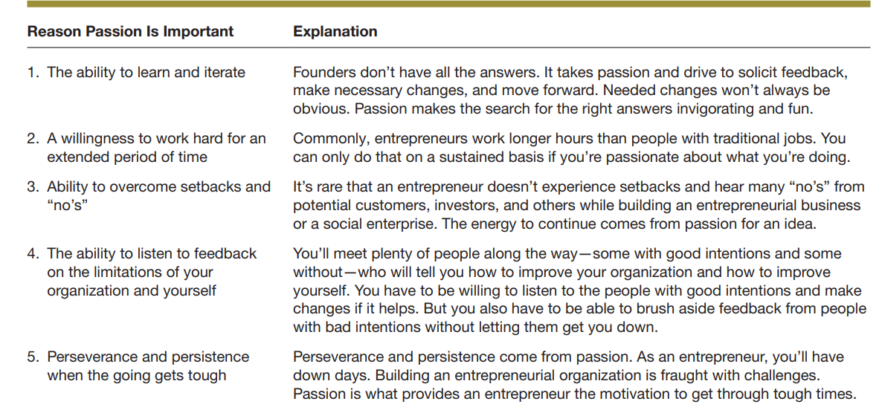
Passion for business

Slide 7
Myths about Entreprenuership
Entrepreneurs Are Born, Not Made
Entrepreneurs Are Gamblers
Entrepreneurs Are Motivated Primarily by Money
Entrepreneurs Should Be Young and Energetic
Entrepreneurs Love the Spotlight

Slide 8
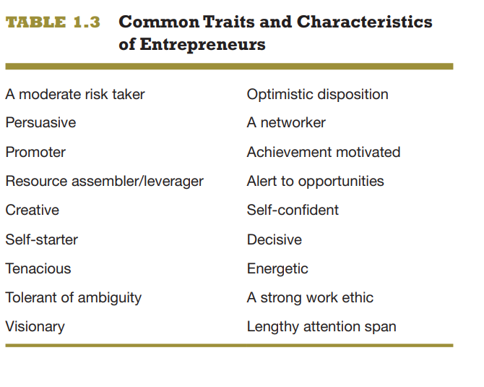

Slide 9
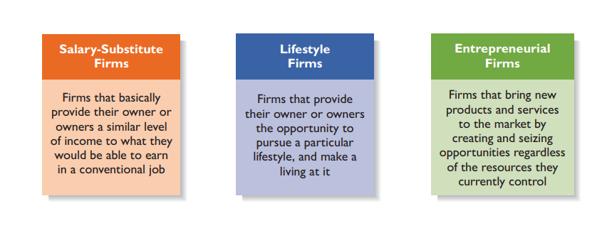
Types of Startup firms

Slide 10
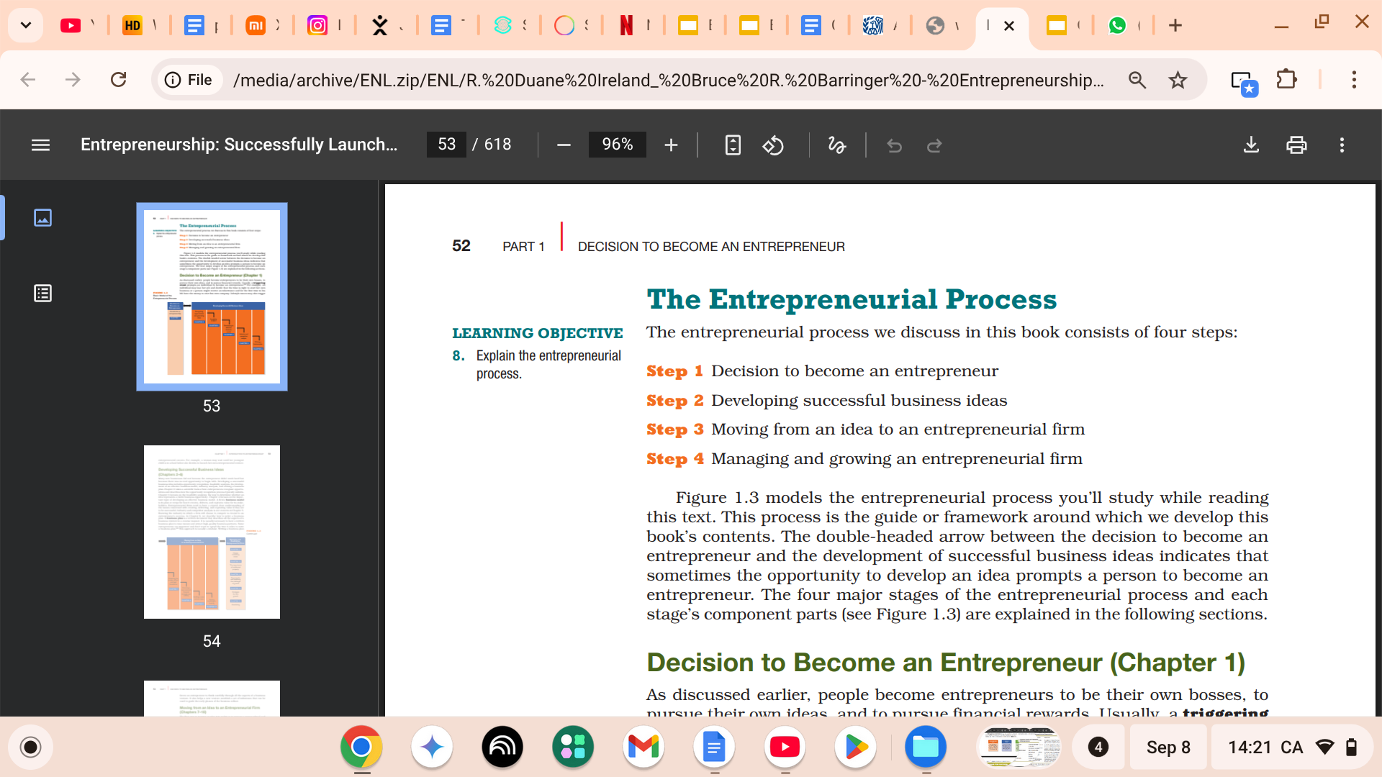

Slide 11
Differences Between Opportunities and Ideas
An opportunity is a favorable set of circumstances that creates a need for a new product, service, or business. Most entrepreneurial ventures are started in one of two ways. Some ventures are externally stimulated. In this instance, an entrepreneur decides to launch a firm, searches for and recognizes an opportunity, and then starts a business, as Jeff Bezos did when he created Amazon.com.
Other firms, such as Wiivv, are internally stimulated. In this instance, an entrepreneur recognizes a problem or an opportunity gap and creates a business to address the problem or fill the identified gap.

Slide 12
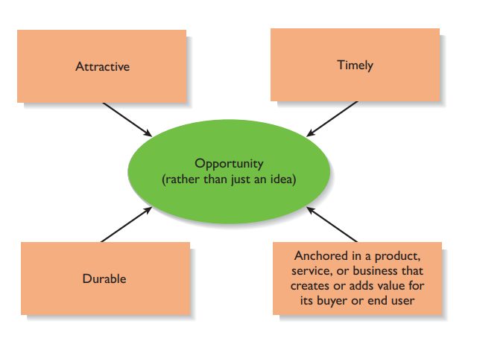
Essential Qualities of an Opportunity

Slide 13
Idea…
An idea is a thought, an impression, or a notion. An idea may or may not meet the criteria of an opportunity. This is a critical point because many entrepreneurial ventures fail not because the entrepreneurs that launched them didn’t work hard, but rather because there was no real opportunity to begin with

Slide 14
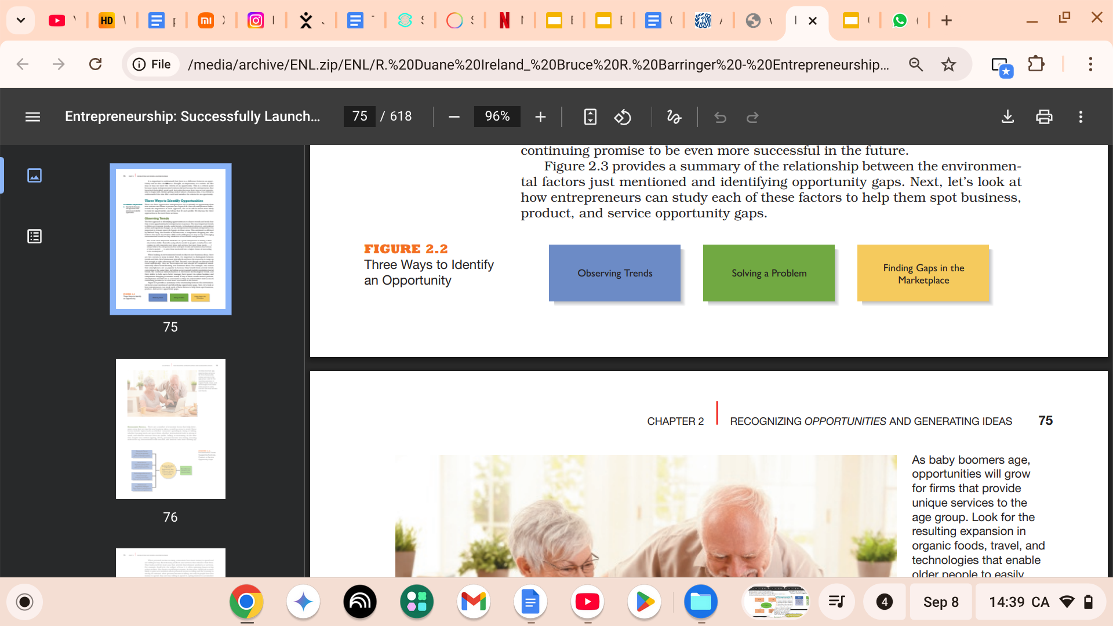
Three ways to identify an Opportunity

Slide 15
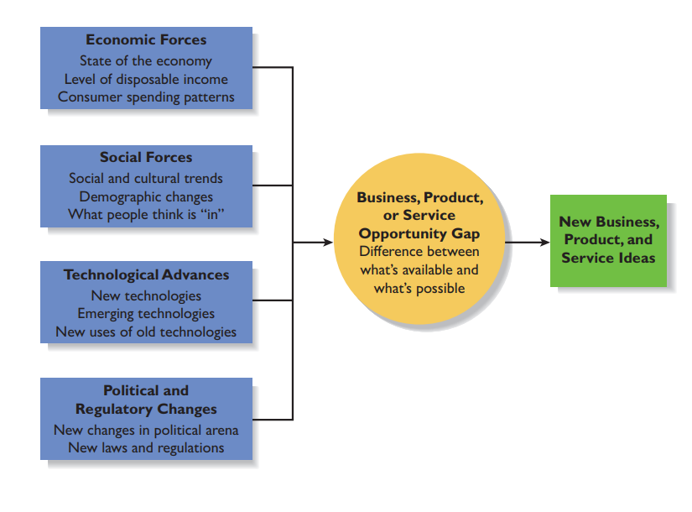

Slide 16
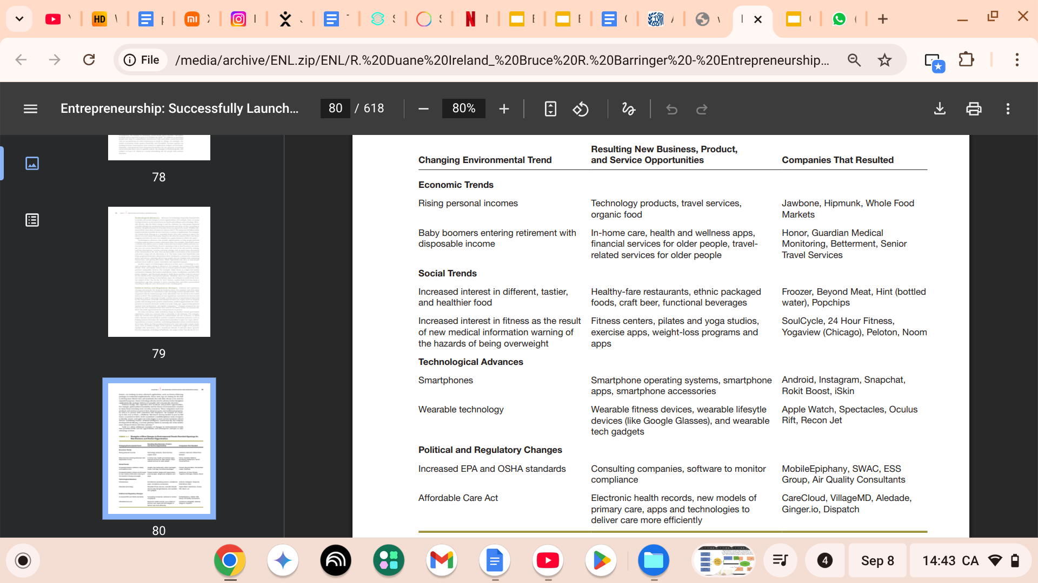

Slide 17


Slide 18
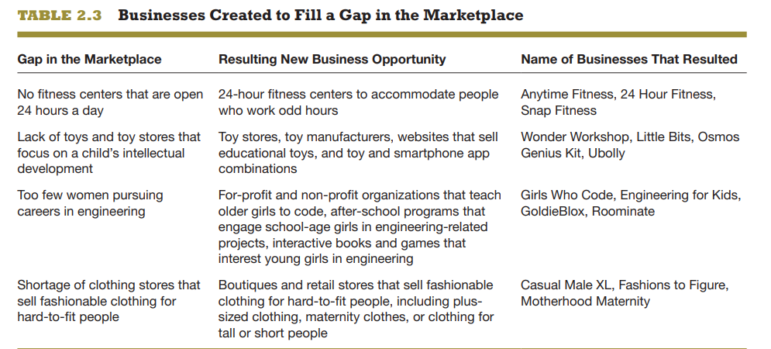

Slide 19
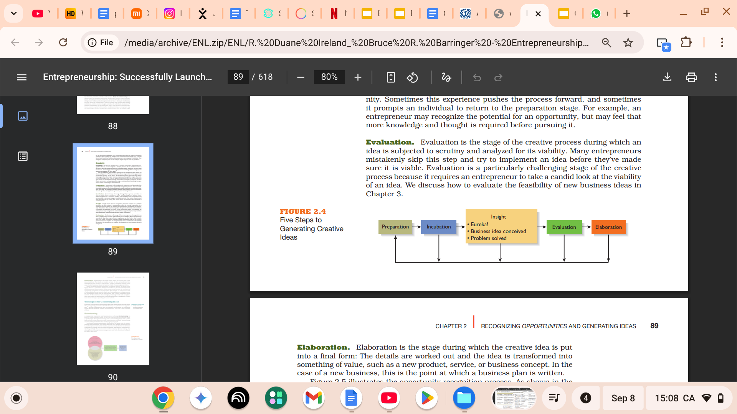
Personal Characteristics of the Entrepreneur
Researchers have identified several characteristics that tend to make some people better at recognizing opportunities than others. The term opportunity recognition refers to the process of perceiving the possibility of a profitable new business or a new product or service.
Prior Industry Experience
Cognitive Factors
Social Networks
Creativity
Preparation
Incubation
Insight
Evaluation
Elaboration.

Slide 20
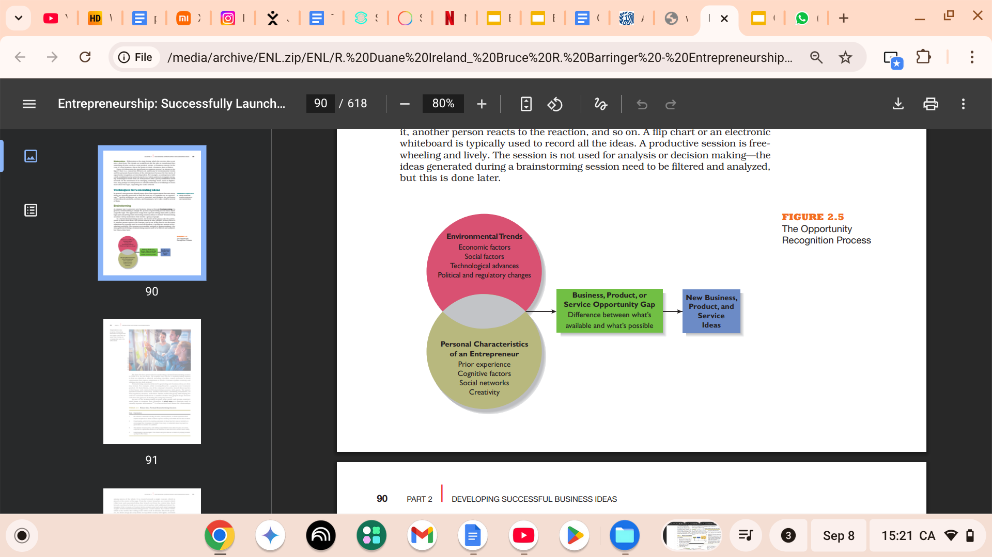
Opportunity Recognition Process

Slide 21
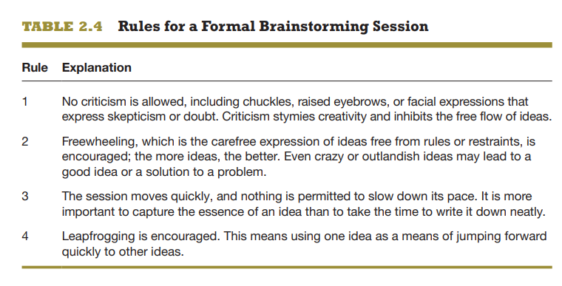
Techniques for Generating Ideas
Brainstorming

Slide 22
Focus Groups
A focus group is a gathering of 5 to 10 people who are selected because of their relationship to the issue being discussed.
Library and Internet Research
A third approach to generating new business ideas is to conduct library and Internet research.

Slide 23
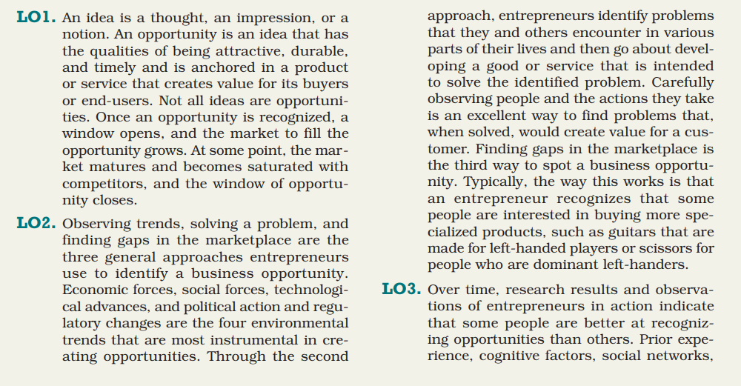

Slide 24
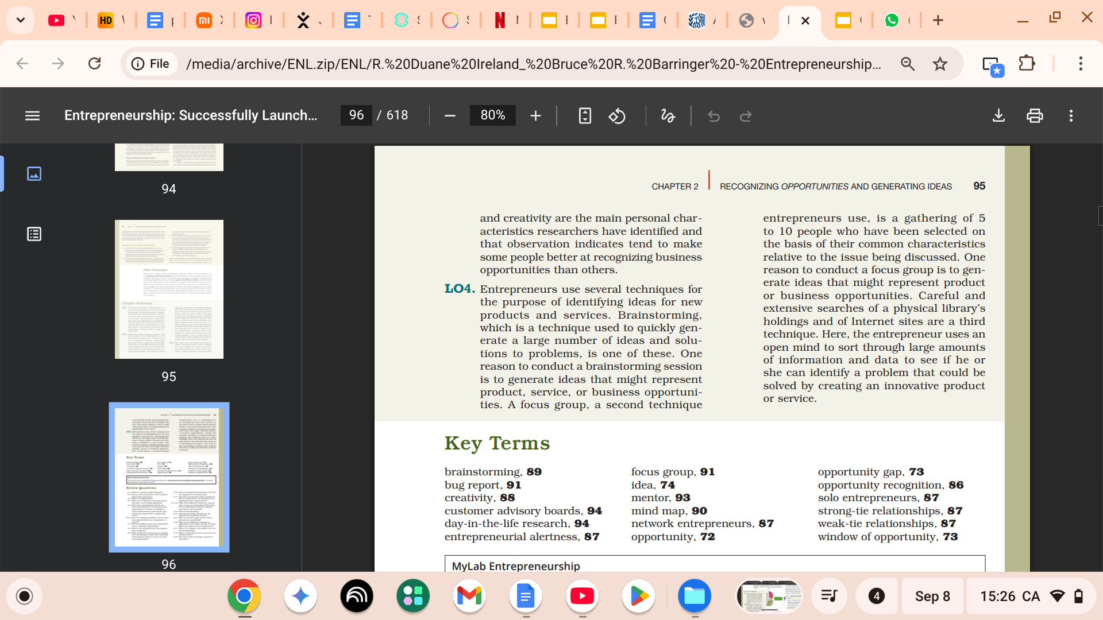

Slide 25
INTRODUCTION TO ENTREPRENEURSHIP
Marriage
Capital
Cheap labor
Emotional Support
Taxation Benefits

Slide 26
INTRODUCTION TO ENTREPRENEURSHIP
Health and Disability
Discrimination
Restriction of time, activity and place

Slide 27
INTRODUCTION TO ENTREPRENEURSHIP
Age , Education and Experience
Experience
Network

Slide 28
INTRODUCTION TO ENTREPRENEURSHIP
Family
Role Models
Experience

Slide 29
INTRODUCTION TO ENTREPRENEURSHIP
Unemployment
Structural Unemployment

Slide 30
INTRODUCTION TO ENTREPRENEURSHIP
Regionality
Structural Unemployment

Slide 31
INTRODUCTION TO ENTREPRENEURSHIP
Immigrants and Ethnic Minority
Employer discrimination.
Access to capital discrimination.
Consumer discrimination.
Ethnic enclaves and geographical clusters where the specific ethnic minority is denser than elsewhere.
The entrepreneurial propensity of the culture of each ethnic group.

Slide 32
INTRODUCTION TO ENTREPRENEURSHIP
Female Entrepreneurs
Discrimination.
Time flexibility (child care, household etc).
Household contribution of the partner.
Education potential and education barriers.
Relative earnings and demand for female workers in the market.
Less self employment income than their male counterparts

Slide 33
INTRODUCTION TO ENTREPRENEURSHIP
Causal thinking VS Effectual thinking

Slide 34
INTRODUCTION TO ENTREPRENEURSHIP
Causal thinking
Causation Process
Start with a desired outcome.
Focuses on the means to generate that outcome.

Slide 35
INTRODUCTION TO ENTREPRENEURSHIP
Effectuation thinking
Effectuation Process
Start with the means that we currently have.
Who we are?
What we know?
Whom we know?
Focuses on the means to generate that outcome.

Slide 36
INTRODUCTION TO ENTREPRENEURSHIP
Professor Saras Sarasvathy
Bird-in-hand principle
You have to create solutions with the resources available here and now.

Slide 37
INTRODUCTION TO ENTREPRENEURSHIP
Professor Saras Sarasvathy
Affordable-loss principle
You should only invest as much as you are willing to lose.

Slide 38
INTRODUCTION TO ENTREPRENEURSHIP
Professor Saras Sarasvathy
Lemonade principle
Mistakes and surprises are inevitable and can be used to look for new opportunities.

Slide 39
INTRODUCTION TO ENTREPRENEURSHIP
Professor Saras Sarasvathy
Patchwork-quilt principle
Entering into new partnerships can bring the project new funds and new directions.

Slide 40
INTRODUCTION TO ENTREPRENEURSHIP
Professor Saras Sarasvathy
Pilot-in-the-plane principle
An effectual worldview is rooted in the belief that the future is neither found nor predicted, but rather made.

Slide 41
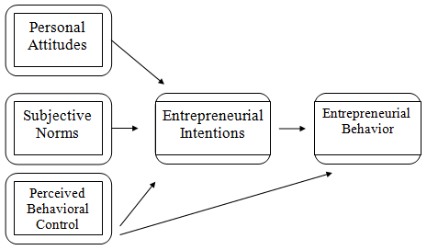
INTRODUCTION TO ENTREPRENEURSHIP
Theory of Planned Behavior ( Izek Ajzen 1991)

Slide 42
INTRODUCTION TO ENTREPRENEURSHIP
Why Become an Entrepreneur?
Controlling Your Destiny
Independence from Supervision
Achieving Great Profits
Tax revenues
Employment
New Products and Services

Slide 43
INTRODUCTION TO ENTREPRENEURSHIP
Macro Economic Factors
Economic development ( Growth of Capital Stock , Technological Progress, Endogenous increase of personal wealth)
Industrial Structure ( Education, Skills)
Government Policy ( Minimum wages , Employees Protection Laws, Interest rate, Retirement Policies)

Slide 44
Thank You

